Slide 1
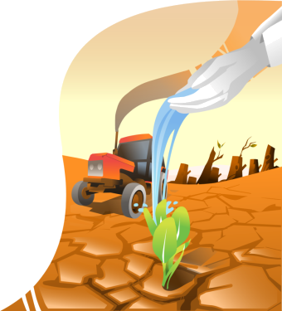


Climate Change
Overview

Slide 2

LEARNING OBJECTIVES
Describe what climate change is.
Identify the main effects of climate change on environment.

Slide 3
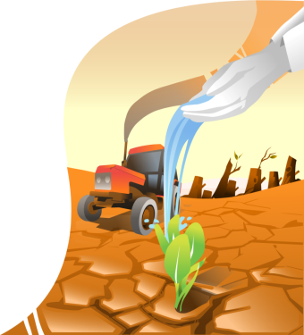
INTRODUCTION
How does climate change affect agriculture and food security?
What can be done to reduce negative impacts and harness opportunities?
Notes:
Notes for trainers:
It is being more and more recognized that there is a link between some recent climate phenomena and climate change.
This course will help you answer these questions.
And what can be done to reduce negative impacts and harness opportunities?
This course will help you answer these questions.
The course will look at the linkages between climate change and food security and explore potential response strategies.

Slide 4
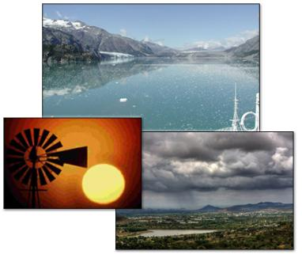
INTRODUCTION
Many natural ecosystems are being affected by global and regional changes in climate.
How are these phenomena linked to climate change ?
Notes:
Notes for trainers:
The global average air temperature is increasing; melting of snow and ice is widespread; precipitation patterns are changing; the global average sea level is rising.
This lesson will help you understand how these phenomena are linked to climate change.

Slide 5

WHAT IS CLIMATE CHANGE?
It is really
hot now. I feel that the entire year is hotter than normal.
This is a clear sign of climate change. Isn’t climate changing as they told us so many times?
Not necessarily. Climate is
always variable. Some years
are hotter than others.
It is not so easy to determine how much of this unusual weather can be attributed to climate change and how much to natural variability of climate.
Claudia
Jacques
Robert
So, is climate change really happening?
Notes:
Notes for trainers:
These people talk about the weather. The conversation raises a couple of questions:
Is climate really changing?
What are the effects of climate change on weather conditions?
During the lesson we are trying to answer these questions.

Slide 6
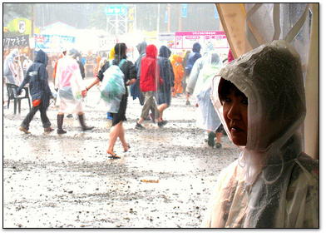
CLIMATE VARIABILITY AND CLIMATE CHANGE
How can we distinguish climate change from natural climate variability?
Notes:
Notes for trainers:
Natural climatic phenomena and variability have always been a challenge for which humans had to develop coping strategies for thousands of years.
However, over the past 150 years, rapid changes in average temperature of unprecedented speed and scale, and consequent long-term changes of climatic trends are unique in a thousand year period.

Slide 7
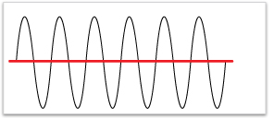
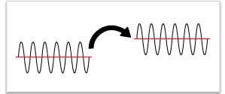
CLIMATE VARIABILITY AND CLIMATE CHANGE
Climate variability
Climate variability refers to natural climate fluctuations, including changes of mean state and varying occurrence of extremes. Thus, climate is naturally in constant change.
mean
Climate change
Climate change, on the other hand, can be detected if standard variations (patterns of climate variability and means) experience significant measurable changes in the long-term.
change
Notes:
Notes for trainers:
Climate variability graph: Variability around the mean as a "characteristic" of the climate.
Climate change graph: Change of the characteristics of climate. Here, a change in the mean state is shown.

Slide 8

CLIMATE VARIABILITY AND CLIMATE CHANGE
Please match climate change and variability with their respective time scale.
Time scales:
Daily, seasonal, inter-annual, several years changes
Long-term trends in variability over the past decades, centuries
Notes:
Notes for trainers:
*Suggested activity: ask learners to do this exercise.
The main difference between climate change and variability is linked with the time scale of observed variations.
Would you be able to match climate change and variability with their respective time scale?
Correct answer:
2: Climate change
Feedback:correct
Only long term variations are related to climate change, while short-term variations depend on climate variability. Climate variability is part of long-term climate change.
1: Climate variability

Slide 9
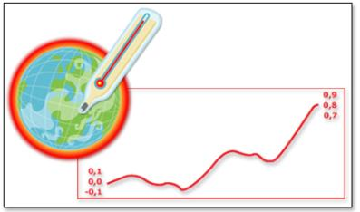
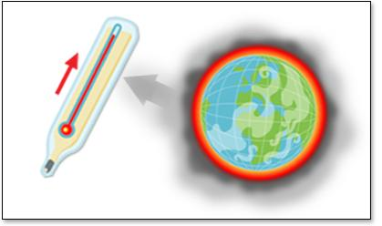
CLIMATE CHANGE EFFECTS
Global warming is the key aspect of climate change.
We are experiencing higher global mean and maximum temperature of air and sea surface.
Temperature (°C)
Relative to preindustrial levels
Greenhouse gases (GHG)
Human activities have a role in global warming.
Notes:
Notes for trainers:
From 1995 to 2006 we have had eleven of the twelve warmest years in the instrumental record of global surface temperature (since 1850).
The temperature increase is widespread over the globe and is greater at higher northern latitudes.
Global mean temperature has increased at the rate of 0.74 °C for the last 100 years, and it is expected to rise between 1.1 to 6.4 °C by the end of the 21st century depending on the various projected scenarios.
Human activities:
The recent trend in temperature rise brought about by the enhanced greenhouse effect is considered mainly as the result of human activities that have increased the atmospheric concentrations of greenhouse gases (GHG) since 1750.
Global greenhouse gas emissions due to human activities have risen by 70% between 1970 and 2004.

Slide 10
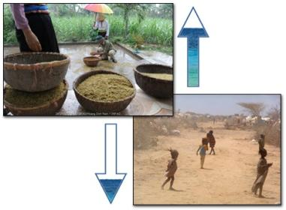
CLIMATE CHANGE EFFECTS
Global mean precipitation is also changing.
Notes:
Notes for trainers:
Mean precipitation:
From 1900 to 2005, precipitation increased significantly in eastern parts of North and South America, northern Europe and northern and central Asia, but declined in the Sahel, the Mediterranean, southern Africa and parts of southern Asia.
Globally, the area affected by drought has probably increased since the 1970s.

Slide 11
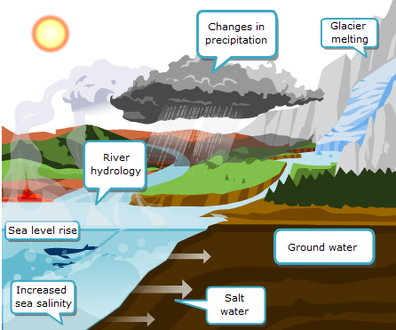
CLIMATE CHANGE EFFECTS
Notes:
Notes for trainers:
The illustration shows how temperature increase triggers alterations in the general circulation of the atmosphere and oceans and average weather conditions.
.

Slide 12
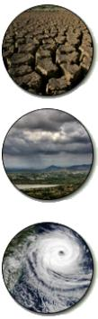
CLIMATE CHANGE EFFECTS
Scenarios projected for some types of extreme events:
Drought
Floods
Tropical cyclones
Notes:
Notes for trainers:
The changes previously described can be considered as gradual.
Nowadays, climate change manifests itself in particular through more frequent and intense extreme weather events, such as cyclones, heat waves, floods and droughts.
Drought
Drought-affected areas are likely to become more widely distributed. Southern Africa, parts of South America, Mexico, the Mediterranean basin and northern China are highly likely to experience harsh drought conditions in the future.
Floods
It is very likely that heavy precipitation events will become more frequent as a result of climate change. Coastal areas, especially heavily populated mega-delta regions in South, East and
South-East Asia, will be at the greatest risk due to increased flooding from the sea and, in some mega-deltas, flooding from the rivers.
Tropical cyclones
Higher sea temperatures are likely to lead to more intense tropical and extra-tropical cyclones. This will directly increase hazard exposure in existing cyclone hotspots, particularly if combined with an increase in the concentration of population and economic activities in these areas. At the same time, higher sea temperatures may also alter cyclone tracks, creating new hotspots exposed to tropical storms that historically have not suffered cyclones.

Slide 13


SUMMARY
Climate change can be detected if standard variations (patterns of climate variability and means) experience significant measurable changes in the long-term.
Global warming is the key aspect of climate change. Temperature increase triggers alterations in the general circulation of the atmosphere and oceans and average weather conditions.
Climate change happens in different ways:
  - increased variability
  - gradual changes in temperature and precipitation
  patterns, and
  - increased frequency of extreme events.

